Slide 1


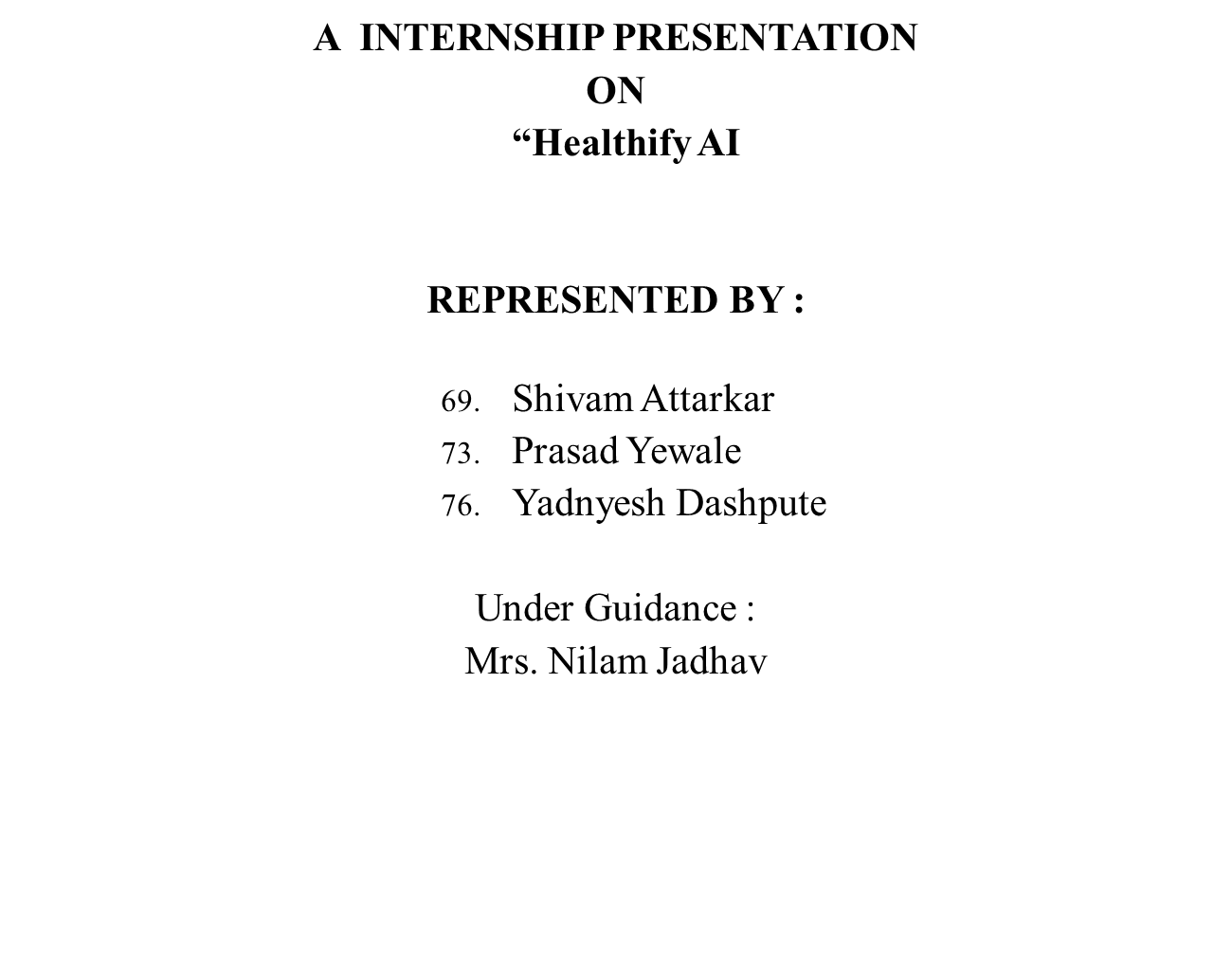
AI-driven Product Classification and Ingredient Extraction )”
Academic Year:2024-25
DEPARTMENT OF COMPUTER ENGG,
PIMPRI CHINCHWAD COLLEGE OF ENGG. & RESEARCH, PUNE

Slide 2
CONTENT
Company Details
Problem Statement
Objectives.
Methodology/Proposed system Block diagram
Software & Hardware requirements.
Results.
Challenges faced
Outcomes(softskills & technical skillsets)
Conclusion & Future Scope
List of References

Slide 3
Company Details
Name of the Company:
Contact Details:
Start Date and End date:
Total no of months:
Stipend(per month)/Total amount:
Internship Mode: (Online/offline)

Slide 4
Problem Statement
Problem Statement:
Consumers often struggle to determine whether a product is healthy or unhealthy based on its ingredient list due to several challenges.
To address this issue, our project aims to automate ingredient analysis using AI. The system will extract text from product labels using Optical Character Recognition (OCR) and analyze the ingredients based on a predefined dataset of healthy and unhealthy substances.
Scope :
This project aims to develop an AI-driven system that analyzes product ingredient lists using OCR and classifies them as healthy or unhealthy using a Random Forest Classifier. It will also provide recommendations for healthier alternatives, helping consumers make informed dietary choices.

Slide 5
Motivation
In today’s world, consumers often struggle to make informed dietary choices due to misleading marketing claims, complex ingredient names, and a lack of awareness about harmful additives.
Many people unknowingly consume unhealthy products, leading to long-term health risks such as obesity, diabetes, and heart disease.
With the increasing reliance on AI and automation, there is a need for a smart system that can quickly analyze product ingredients.
This project aims to bridge that gap by leveraging AI and Machine Learning to empower consumers with accurate, real-time insights about the healthiness of their food choices, ultimately promoting healthier lifestyles.
November 9, 2017
Prasad Chaudhari

Slide 6
Objective
The primary objective of this project is to develop an AI-powered system that helps consumers determine whether a product is healthy or unhealthy based on its ingredient list. The system will:
Extract ingredient information from product labels using Optical Character Recognition (OCR).
Analyze ingredients by comparing them with a predefined dataset of healthy and unhealthy substances.
Classify products as healthy or unhealthy using a Machine Learning model (Random Forest Classifier).
Enhance consumer awareness by simplifying complex ingredient information and reducing reliance on misleading marketing claims.
November 9, 2017
Prasad Chaudhari

Slide 7
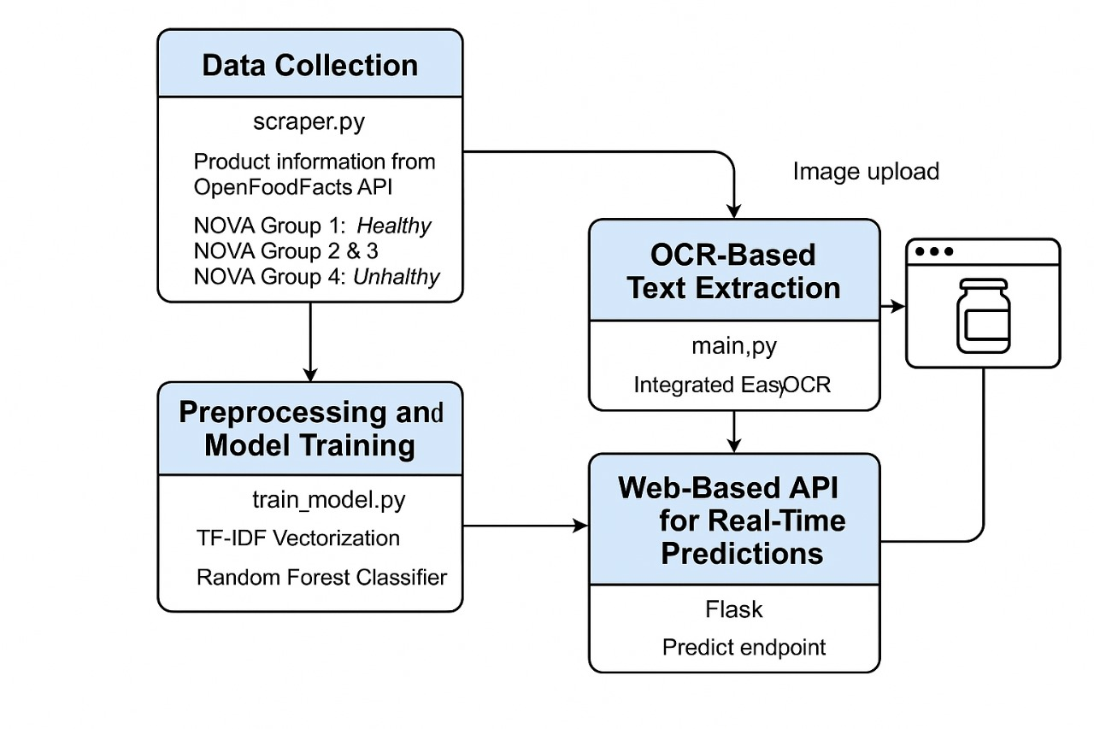
Proposed System(Diagram)
Unhealthy

Slide 8
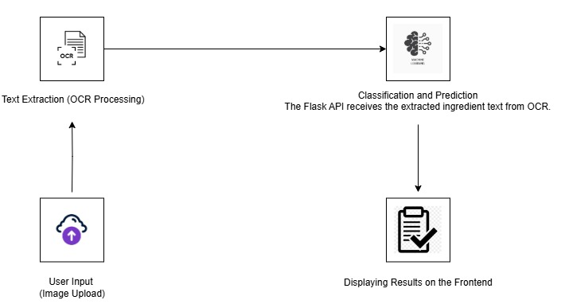
Diagram explanation

Slide 9
ALGORITHMS
The Random Forest Classifier is used as the primary machine learning model for classifying food ingredients based on their health impact.
It is learning method that constructs multiple decision trees during training and outputs the majority vote of these trees for classification.
This technique enhances prediction accuracy by reducing overfitting, which is common in single decision trees.
The classifier is trained on a dataset of food ingredients labeled with their health status.
During training, the algorithm learns patterns in ingredient names and their corresponding health labels, enabling it to generalize well on new data. By leveraging multiple decision trees, the Random Forest model increases robustness and provides reliable classifications, ensuring that the system can accurately differentiate between healthy, moderately healthy, and unhealthy ingredients.

Slide 10
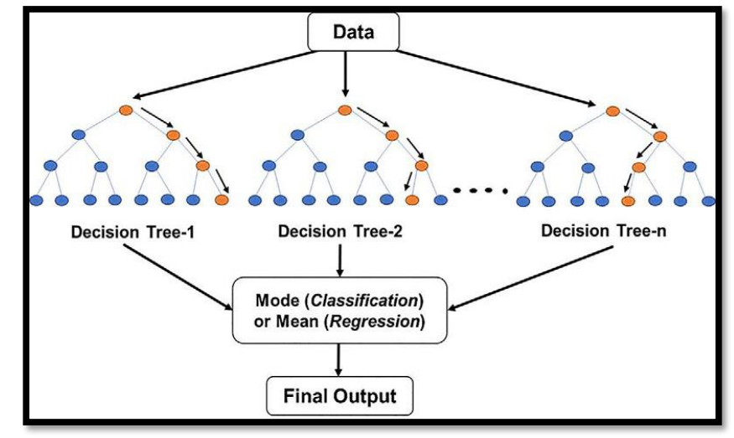
DIAGRAM
Fig – Random Forest Classifier

Slide 11
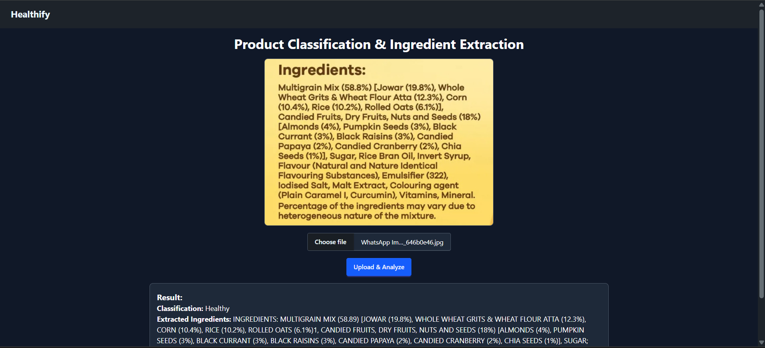
Screen shoots of project implemented or execution
Fig. Healthy Packaged Food

Slide 12
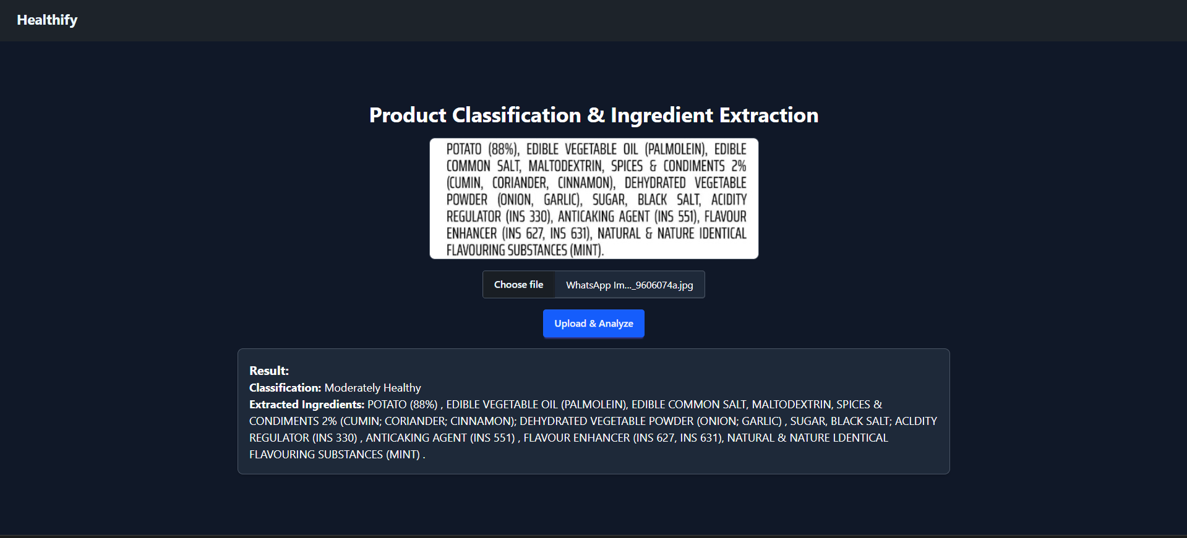
Screen shoots of project implemented or execution
Fig. Moderately Healthy Packaged Food

Slide 13
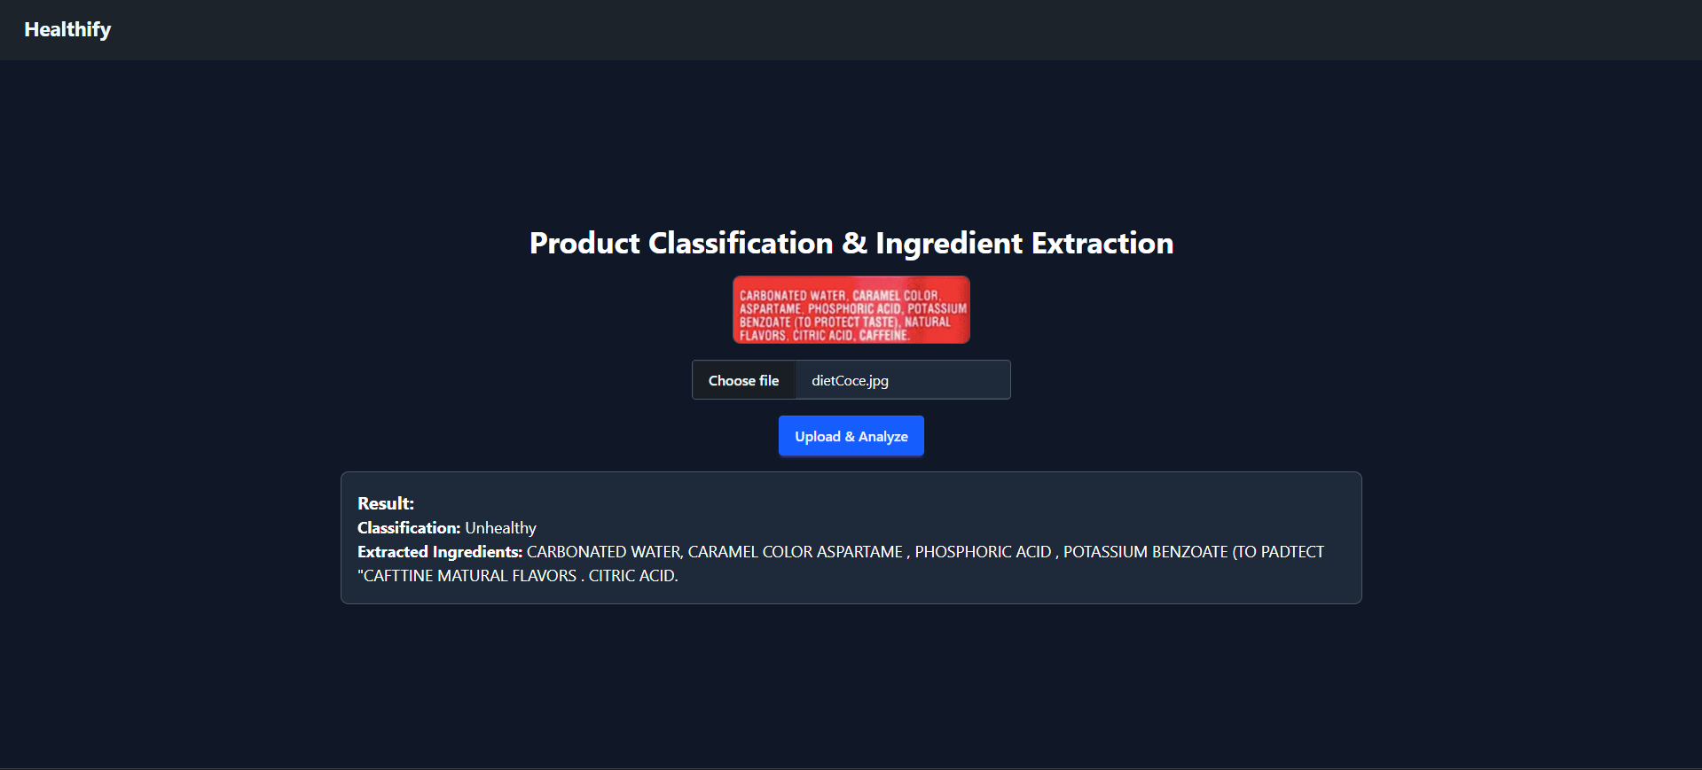
Screen shoots of project implemented or execution
Fig. Unhealthy Packaged Food

Slide 14
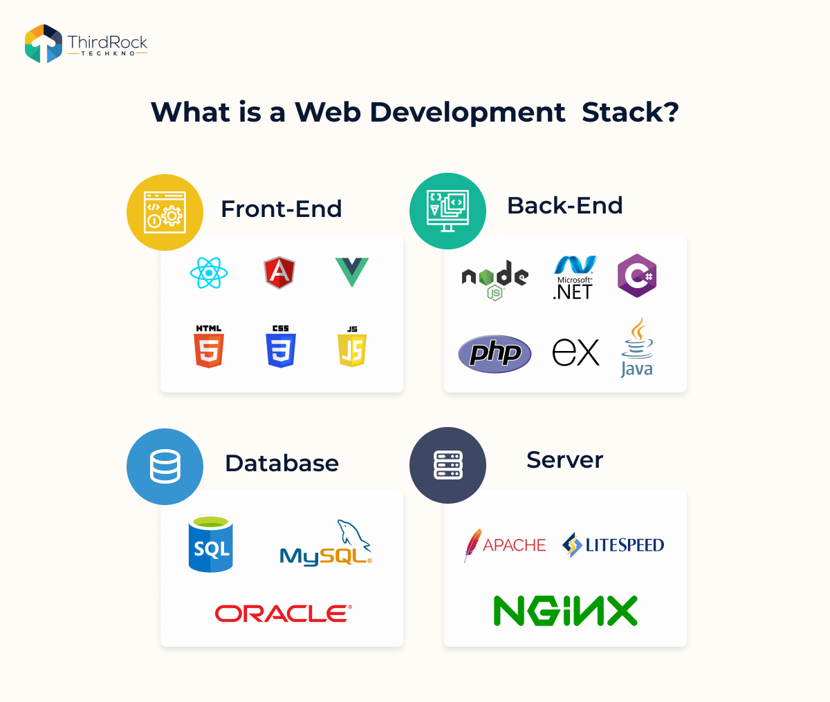




Front End & Back End platform

Slide 15
Result
November 9, 2017
Prasad Chaudhari

Slide 16
Challenges Faced
  OCR Challenges –
  Difficulty in accurately extracting text from blurry or low-quality images.
  Handling different font styles, sizes, and handwritten text.
  Ingredient Database Issues –
  Maintaining a comprehensive and updated list of healthy and unhealthy ingredients.
  Dealing with variations in ingredient names and synonyms (e.g., sugar vs. glucose vs. fructose).
  Misleading Marketing & Labeling –
  Some food products use deceptive terms to appear healthier (e.g., "natural flavors").
  Some Identifying hidden harmful additives in ingredient lists.
November 9, 2017
Prasad Chaudhari

Slide 17
Future Scope
  Enhancing OCR Accuracy: Implementing deep learning-based OCR models like Tesseract with LSTM or Google Vision API for better text extraction, especially for blurry or handwritten labels.
  Multilingual Support: Expanding OCR and text classification to support multiple languages, making the system more accessible for global users.
  Nutrition Fact Analysis: Extending the classification to include additional nutritional details such as calories, sugar content, and artificial additives for a more comprehensive health analysis.
  Mobile App Integration: Developing a mobile application for real-time food scanning, allowing users to check food health ratings on-the-go.

Slide 18
Conclusion
This project demonstrates an AI-powered food ingredient classification system that enhances consumer awareness regarding the healthiness of packaged food.
By integrating OCR, Natural Language Processing, and Machine Learning, the system automates ingredient analysis and provides real-time classification.
The use of TF-IDF vectorization and a Random Forest Classifier ensures high accuracy in ingredient classification.
The developed API enables seamless integration into mobile or web applications, making it highly scalable and adaptable for further improvements.

Slide 19
References
OpenFoodFacts API Documentation: https://world.openfoodfacts.org/data
EasyOCR: https://github.com/JaidedAI/EasyOCR
Scikit-learn: https://scikit-learn.org/stable/
React.js Documentation: https://react.dev/
Flask Documentation: https://flask.palletsprojects.com/en/2.0.x/

Slide 20


